Slide 1
Advanced APIs
3APIS

Slide 2
3APIS – Advanced APIs
Course Objectives
By the end of the course, students should:
Be able to work with files upload
Understand the difference between HTTP and Websocket
Be capable to create a Websocket client/server

Slide 3
Summary
Files
HTTP / WebSocket
WebSocket

Slide 4
1. Files

Slide 5
1. Files
During the previous days we have seen how to handle and work with various data type in a REST API with Node.js. Yet we didn't discuss about a data type that we use daily: binary file
Sharing picture, images, videos is something that we do even without thinking about it. Did you post a picture of your breakfast today ? Maybe you sent an excel file to someone ? Did you dance and upload a video of the latest TikTok trend ?
In any case, uploading a file is quite a common thing to do and you need to know how to handle that in your API.

Slide 6
1. Files
Uploading files via API involves sending files from a client (e.g., a web browser or another server) to a server, which then processes and stores the files.
This is a common requirement for applications dealing with media, documents, or any data that requires file storage.

Slide 7
1. Files
HTTP Methods for File Upload
POST Method:
The most common method for file uploads is the HTTP POST method. When a client sends a POST request to the server with a file attached, the server processes the file and stores it.

Slide 8
1. Files
Multipart/Form-Data
Content-Type:
File uploads are typically performed using the multipart/form-data content type. This allows clients to send binary data, including files, in a structured way.
Form Fields:
In a multipart/form-data request, each file is associated with a form field. Additional metadata, such as file name, content type, and any other relevant information, can be included as form fields.

Slide 9
1. Files
API Endpoints for File Uploads
Single File Upload:
An API endpoint that accepts a single file in the request payload.
Multiple File Upload:
An API endpoint that supports uploading multiple files in a single request.

Slide 10
1. Files
Server-Side Handling
File Storage:
The server needs to handle storing the uploaded files. It may save files on the local file system, in a cloud storage service, or a database, depending on the application's requirements.
Validation:
Server-side validation is essential to ensure that the uploaded files meet the specified criteria, such as file type, size limits, and other constraints.

Slide 11
1. Files
Security Considerations
File Type Verification:
Verify that the uploaded files have the expected file type to prevent malicious uploads.
Size Limits:
Set limits on file sizes to prevent abuse and denial-of-service attacks.
Authentication and Authorization:
Ensure that only authorized users can upload files, and implement proper authentication mechanisms.

Slide 12
1. Files
Thanks to body-parser in Node.js (or any other middleware) you know how to work with json objects.
To work with file, the same middleware is not enough, you need a new one: Multer (this is the most used but there is others).

Slide 13
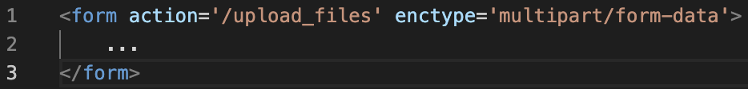
1. Files
Working with file upload change the way the data is being sent. If you work with a normal form, only a basic json body is being sent.
When also sending a file (any kind of file) you will be working with a multipart/form-data enctype.

Slide 14
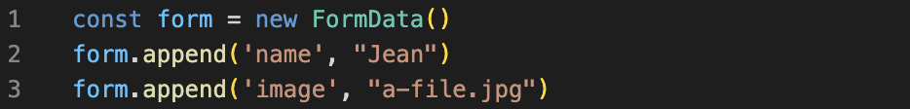
1. Files
This use the formData API which can also be used in Javascript like so.

Slide 15
1. Files
Now that we do now a bit more, what is Multer and how can we use it?
Like we said - or I guess you could expect - Multer is a middleware designed to handle multipart/form-data in forms and is only supporting that !
We can setup our base Express.API as follow - without multer first.

Slide 16
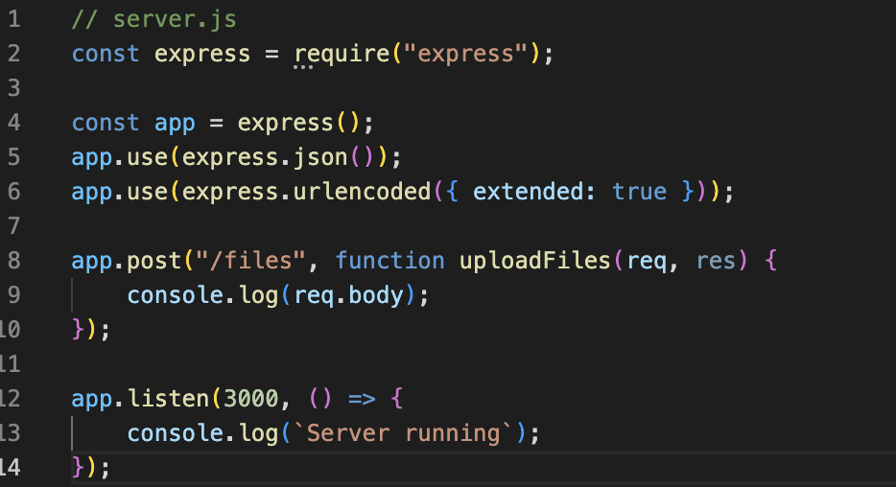
1. Files
Nothing fancy, just a base file for a server with express, with one endpoint

Slide 17
1. Files
As you can see we define our endpoint as we would processing only json data fields. Now let's use multer to handle our formData.
On the top of the file, we need to require multer and then configure it. The minimal configuration is to define where the files need to be saved.

Slide 18
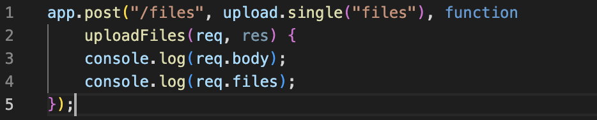
1. Files
And we need to say to our Node.js application that for this specific endpoint we want to use the multer middleware to handle the file (or files) being sent.

Slide 19
1. Files
We simply added upload.single("files") to our endpoint ! And it is important to note that the files value depend of the name of your input on your HTML page.
To handle multiple files, use upload.array.
And here you go ! A fully functional endpoint to upload and store file in Node.js
You can find a full example here

Slide 20

Exercises

Slide 21
2. HTTP / WebSocket

Slide 22
2. HTTP / WebSocket
While REST API is the most used concept of data exchange currently used on the internet this is not a silver bullet for all use case.
Imagine that you are creating a chat application and you want your users to receive the message almost instantaneously - as a real-time application.
Or maybe you are trading some stock and want to see a live chart of the value and all buy/sell done be others users
How can you do that in HTTP ?

Slide 23
2. HTTP / WebSocket
The first idea that come to mind would be to fetch every X seconds. Maybe 5s is enough for a chat, but if you are in a stock exchange maybe the price will drop by 1% ? Or increase by 1%. Or someone already bought it and you are too late
So we want to do it every 0.5s? Seems almost imperceptible for an user (around 200ms for a OK loading time of a page). But imagine you are on some social media speaking with 20 different friends.
This mean than only you will be sending 20 HTTP calls * 2 per second = 40 HTTP calls per seconds.

Slide 24
2. HTTP / WebSocket
If your application is running and it is in the middle of the night you will be sending API requests for nothing - yet still consuming network, bandwidth, CPU on the server, run database queries...
Not really optimal right ?

Slide 25
2. HTTP / WebSocket
How is it done in normal life?
Imagine you are in a restaurant and you already ordered some food (ordering food could be our normal HTTP call).
You don't ask your waiter every minutes when is my food coming (at least I hope you don't do that ).
You are patiently waiting for him to bring the food.
From a querying point of view you are in a waiting something state (here food - in our API case some more data)

Slide 26
2. HTTP / WebSocket
WebSocket is a communication protocol that provides full-duplex communication channels over a single, long-lived connection. It is designed to be used by web browsers and web servers for real-time communication.
WebSocket enables bi-directional communication, allowing data to be sent between a client (typically a web browser) and a server with lower latency and overhead compared to traditional HTTP connections.

Slide 27
2. HTTP / WebSocket
Key Features
Full-Duplex Communication:
Unlike traditional request-response communication in HTTP, WebSocket allows both the client and server to send messages independently at any time. This enables real-time, bidirectional communication.
Low Latency:
WebSocket reduces latency by eliminating the need to establish a new connection for each exchange of data. The persistent connection is kept open, allowing for quicker data transfer.

Slide 28
2. HTTP / WebSocket
Key Features
Efficient Use of Resources:
WebSocket uses a single, long-lived connection that remains open, reducing the overhead of repeatedly opening and closing connections for each data exchange.
WebSocket API:
Browsers provide a JavaScript API (WebSocket API) that allows developers to interact with WebSocket connections. This API includes methods for opening, closing, and sending messages over WebSocket connections

Slide 29
2. HTTP / WebSocket
Use Cases
Real-Time Web Applications:
WebSocket is commonly used in real-time web applications where instant updates and communication between clients and servers are crucial, such as chat applications, live collaboration tools, and online gaming.
Financial Trading Platforms:
WebSocket is employed in financial applications where low latency and real-time updates on stock prices or other financial data are essential.
Live Streaming:
Live streaming platforms use WebSocket to provide real-time updates on live events, comments, and interactions.

Slide 30
2. HTTP / WebSocket
Use Cases
Collaborative Editing:
Platforms that support collaborative editing, such as Google Docs, leverage WebSocket for instant synchronization of changes made by multiple users.
IoT (Internet of Things):
WebSocket is suitable for IoT applications where devices need to communicate with a server in real-time, exchanging data and receiving updates.

Slide 31
2. HTTP / WebSocket
WebSocket significantly improves the efficiency of real-time communication on the web by offering a persistent, low-latency connection.
Its simplicity and wide support make it a popular choice for developers building applications that require instant updates and interactive features.

Slide 32
2. HTTP / WebSocket
Few important information
there is one websocket spec linked to HTML5 (since 2010)
you can implement the native version or use a library on top of it
we will be using socket.io (most used websocket library)
between normal HTTP call and websocket there is also something called SSE (server side event)

Slide 33
Exercises

Slide 34
3. WebSocket

Slide 35
3. WebSocket
Socket.IO is a JavaScript library that enables real-time, bidirectional communication between web clients and servers.
It is build on top of the WebSocket protocol but provides additional features, such as fallback mechanisms for environments where WebSocket is not supported.
Socket.IO is widely used for building real-time web applications, chat applications, online gaming platforms, collaborative tools, and more.

Slide 36
3. WebSocket
In our project let's install our socket.io library

Slide 37
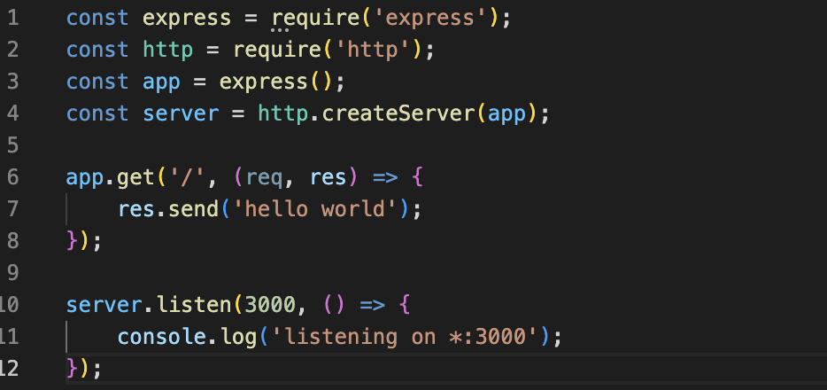
3. WebSocket
And we can define our basic HTTP app as such

Slide 38
3. WebSocket
Nothing new yet ! We can now add our socket.io part. On top of the file we do require the library

Slide 39
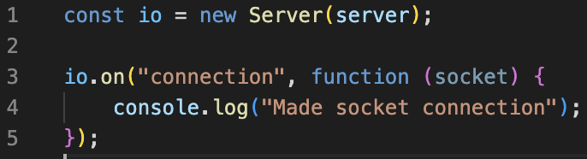
3. WebSocket
After all the code we can implement our socket part

Slide 40
3. WebSocket
If you use Postman with a workspace (require a postman account) you can use it to try your websocket server.
> New > Create WebSocket Request > Follow the steps
You could also use cURL if you want to do it manually from your terminal (multiples setup you can find online)
Or you can write a quick front end!

Slide 41
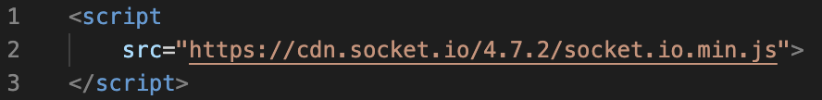
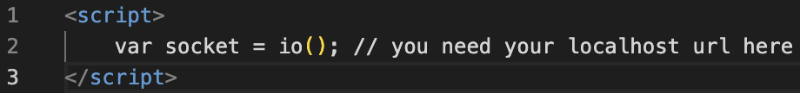
3. WebSocket
In your frontend you need to load the client side of the library
And instantiate it

Slide 42
3. WebSocket
If you want to send a message from the frontend you need to do some JS + HTML work to handle client action, and add some socket.io code to emit (or send) some values to the server.
This will emit a message (here the content will be my data from a variable) and sent it on the channel chat.

Slide 43
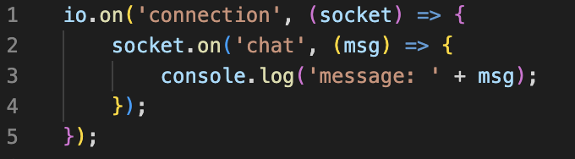
3. WebSocket
On your server side you need to listen to this specific channel

Slide 44
3. WebSocket
And that is all ! You are already able to send message from multiple frontend to your server. But not yet to others users !
Socket.io is pretty simple, you just need to redo the same code you already wrote but the opposite way
server is emitting
client is receiving

Slide 45
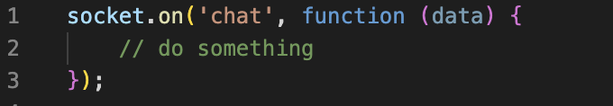
3. WebSocket
On your frontend part, you want to listen to message sent by the server to a specific channel.

Slide 46
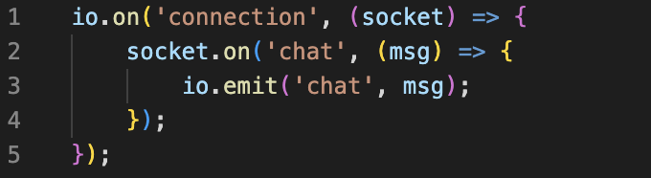
3. WebSocket
While on your backend, you want to send the message you received to all other listener on this specific channel.
Here we say with the code:
Each time you receive a message on the chat channel (one direction front client to server),
have the server emit the same message on all actives sockets (server to all clients => broadcast)

Slide 47
3. WebSocket
And you now know how to use and create a websocket API !
Of course this is only the beginning. Socket.io propose a vast API. Others way to broadcast, how to reconnect if there is some disconnection ... You can look all that up.
A quick example can be found here

Slide 48
Exercises

